Slide 1


Understanding Pronouns
Writing Support Desk
writingsupport@uwindsor.ca
Notes:
1

Slide 2

WHAT IS INCLUSIVE LANGUAGE?
Language that does not exclude or other individuals or groups
Language that does not perpetuate discrimination or stereotypes
Language that strives for equity & to avoid harm
5
Notes:
2

Slide 3
WHY USE INCLUSIVE LANGUAGE?
Language is powerful. It not only describes but can perpetuate and create our realities.
Respect for others is paramount. Inclusive language demonstrates respect.
UWindsor is committed to equity, diversity, and inclusion.
5
Notes:
3

Slide 4

LANGUAGE & GENDER
Much commonly used language is gendered, even if we do not notice
Using gendered terms and language can exclude people
Use gender-neutral terminology to be inclusive
mankind
spokesman
ladies and gentlemen
guys
AVOID
USE
spokesperson
humankind
distinguished guests
people, friends, folks, all
Notes:
4

Slide 5
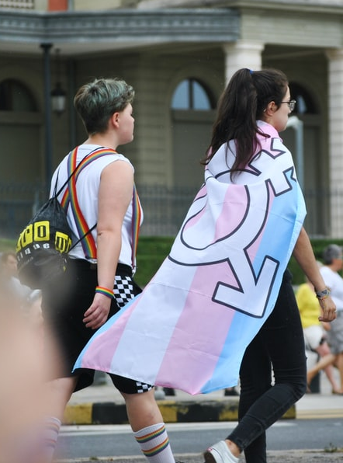
GENDER IDENTITY
Is distinct from sexual orientation
Is each individual’s sense of their own gender
Exists on a continuum, not as a binary of male/female
Language should be inclusive of cis, trans, non-binary, Two-Spirit, gender-non-conforming, and all gender-expansive people.
Notes:
5

Slide 6
PRONOUNS, TITLES, & GENDER
Singular “they” is grammatically correct when the gender of the subject is unknown or the subject uses they/them pronouns
Pluralizing can also help keep phrases gender neutral
Dr. is a gender-neutral honourific for anyone with a doctorate
Do not assume someone’s gender/pronouns/honourific
his/her
each student should choose his classes
Ma’am, Sir, Mr., Mrs., Ms. (when gender is assumed/unknown)
AVOID
USE
each student should choose their classes OR students should choose their classes
their
Dr. (when applicable) or ask for the appropriate honourific
Notes:
6

Slide 7
PRONOUNS, TITLES, & GENDER
Always use the correct pronouns identified by an individual. Be aware that they may use neo-pronouns (ex. xe/xem/xyr) or gender-neutral pronouns (they/them)
In research, avoid providing only binary options for participants to declare gender or pronouns
Select gender: male or female
Select pronouns: he/him, she/her, or they/them
AVOID
USE
Write in your pronouns
Write in your gender
Notes:
7

Slide 8
Quick Tips
If you are meeting someone for the first time and do not know their pronouns, ask them.
Focus on communicating clearly and respectfully.
It is okay to make mistakes when you misgender someone, as long as you apologize and correct yourself.
Notes:
8

Slide 9
QUESTIONS?
Remember, this slideshow and many others are available to download via the Writing Support Brightspace page.
Students can self-enroll as 'learners' either by selecting 'Discover' from the Brightspace landing page and clicking 'Enroll' on the Writing Support organization.

